Slide 1
ABAP Part II
Lesson 12: Transports

Slide 2
Lesson Objectives
After completing this lesson, participants will be able to know the following -
Basics of Transport control
Transport with Import Queue
Procedure of Mass or Single Import
Transport Strategy
Transport Organizer
Types of Requests

Slide 3
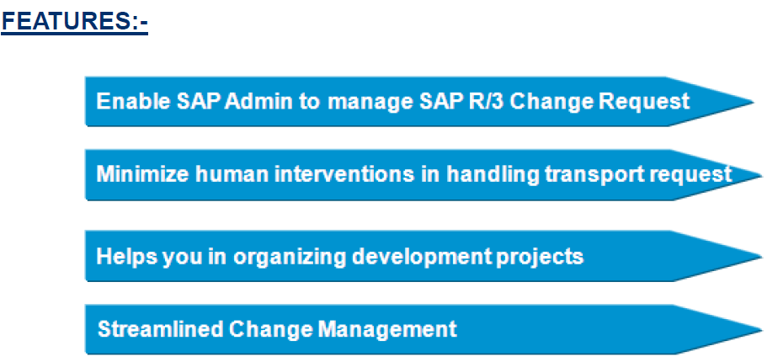
Introduction
SAP's Transport management system represents the centralized
change and transport system CTS for all R/3 systems.

Slide 4
Introduction
The Change and Transport System (CTS) is a tool that helps you to organize development projects in the ABAP Workbench and in Customizing, and then transport the changes between the SAP Systems in your system landscape
CTS records all changes in change requests
Changes in change requests can be linked together logically, or can be completely independent of each other
When you have finished your work, you can release the task & request respectively
The change request is then used to copy the changes from this client to other clients or systems. This automatic procedure is known as a transport.
Transports of changes by the CTS allow you to develop in one environment, test your development work in a test environment, and then, if the tests are successful, use it productively.

Slide 5
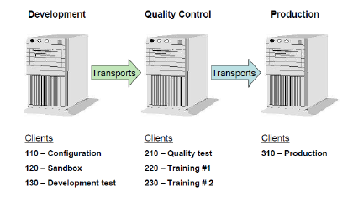
Clients and their Roles
We can divide clients into mainly three categories :-
1.DEV/CUST :-SAP system landscape requires a client where Customizing settings, and possibly ABAP Workbench developments, can be made. client is known as the Customizing and development client, or Customizing client for short. The abbreviation DEV/CUST is used for this client
2.QAS/QTST :-Before you can use the Customizing settings and Workbench developments productively, you need to test them extensively for errors. The client where these tests are made is the Quality Assurance Client, QAS/QTST for short.
3.PRD/PROD :-Separate client is required for productive use of the SAP LIVE System. This client is known as the Production Client, PRD/PROD for short.

Slide 6
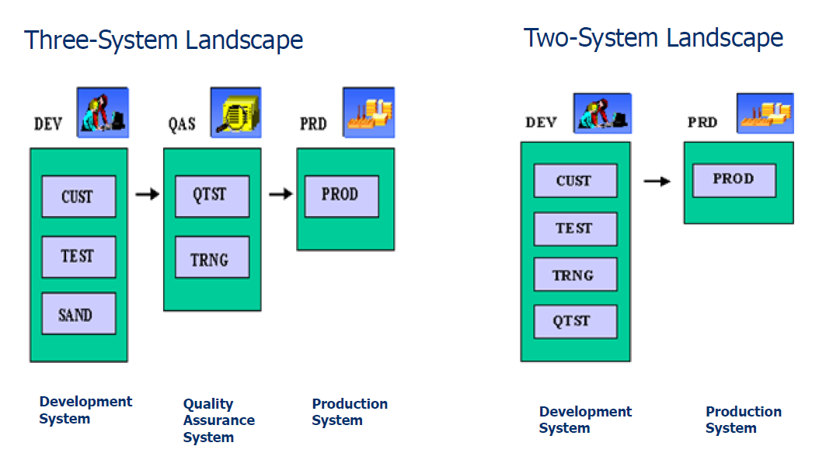
System Landscape

Slide 7
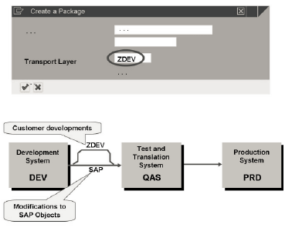
Transport Layer
A transport layer is assigned to each development class and thus to all the objects in that class.
Transport layer determines :-
In which SAP system development or changes to the repository objects are made.
Whether objects are transported to other system within the group.
All the project developed in the same system and transported on the same transport route are grouped together to form a transport layer.

Slide 8
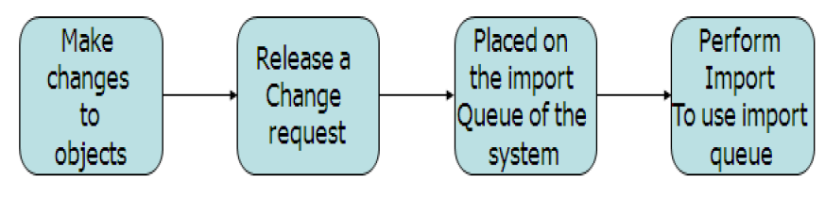
Transport with Import Queue
Any changes to customizing object or Repository object in the development system, do not automatically transported to target system.
Two procedures to use import Queue to perform import by BASIS team:-
1.Mass Transport
2.Single Transport

Slide 9
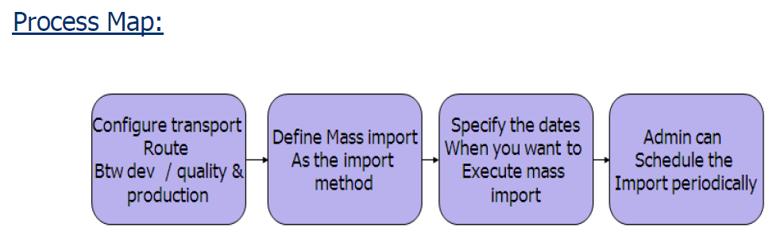
Transport with Import Queue
Procedure of Mass Import
1.This procedure imports all the request waiting for import in the queue.
2. This is good solution if we have large number of transport to administrator.
3. It’s a secure way.

Slide 10
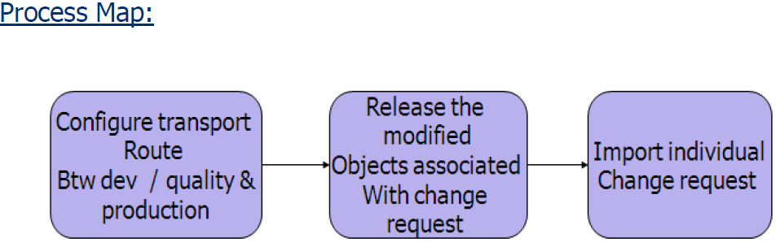
Transport with Import Queue
Procedure of Single Import
Basis team opts for Single Import under following situation :-
1. For frequent transportation.
2. If organization doesn’t include fixed import times.
3. Or if we want to maintain production system directly with correction

Slide 11
Transport Organizer
A set of tools in the SAP systems for managing development project in the ABAP workbench and in customizing and for preparing and managing transportation between the SAP system.
Features :-
Transaction SE09 or SE10
Provide functions for create, document and release of change request/Task.
There are multiple ways to manage and record the changes for the object, which are being discussed further.
Steps involve while working with the Transport Organizer :-
1. Record Changes in the Change request for repository object
2. Working with Change request from creation to release.
3. Checking whether transported request were successful or not.

Slide 12
Types of Request
A source of information in the transport organizer that records and manage all the modifications made to repository and customizing settings during a development work.
Types :-
1.Workbench Request
2.Customizing Request
3.Transport of Copies
4.Relocations

Slide 13
Types of Request
Workbench Request
A source of information in the transport organizer that records and manage all the modifications made to repository and customizing settings during a development work.
Few Points:-
For every change to the repository object we need to assign that to specified workbench request.
From the system setting (if transport route is defined for the package of these objects) system determines if whether the change request are transportable and to which target system.
We can only save the changes if we assign object to a change request.

Slide 14
Types of Request
Customizing Request
Few PoChange request for copying and transporting changed system settings from client specific tables.
ints:-
Customizing request record client-specific customizing settings made in a single client and usually these will be done in transaction SPRO.
Customizing request in the SAP System are all transportable or local depend on System settings.
System uses Standard Transport layer to determine automatically if change request are transportable and to which target system.
We can only save the changes if we assign object to a change request

Slide 15
Types of Request
Transport of Copies
Transport object to a specified SAP system.
Objects are transported with the current version in SAP system.
Original location of the object will remain
No delivery to another SAP System

Slide 16
Types of Request
Modifiable Request
The user can use modifiable requests and tasks in the Transport Organizer to edit and transport below repository entries/objects
ABAP workbench objects
Customizing settings
Table entries

Slide 17
Types of Request
Release Requests
The user cannot use released requests and tasks in the Transport Organizer to edit below repository entries/objects
ABAP workbench objects
Customizing settings
Table entries
If user wants to do any modifications for the objects which are in released transport, he has to create new transport for them

Slide 18
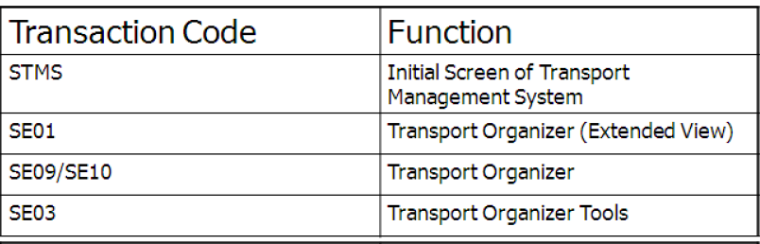
Transaction Codes

Slide 19
Summary
In this lesson, you have learnt:
Basics of Transport control
Transport with Import Queue
Procedure of Mass or Single Import
Transport Strategy
Transport Organizer
Types of Requests

Slide 20
Review Question
Question 1: The client can be divided in to three categories namely _______, _______ and ______.
Question 2: ____ is the transaction code for transport organizer.

